Slide 1


Team Name: AgriVision
Team Name: AgriVision
Project Name: Intelligent Farm Surveillance System
Project Name: Intelligent Farm Surveillance System
Track: Maker Fair
SDG Goal Focused: Zero Hunger, Good Health and Well-being, Industry, Innovation, and Infrastructure, Responsible Consumption and Production, Climate Action, Life on Land
Track: Maker Fair
SDG Goal Focused: Zero Hunger, Good Health and Well-being, Industry, Innovation, and Infrastructure, Responsible Consumption and Production, Climate Action, Life on Land

Slide 2

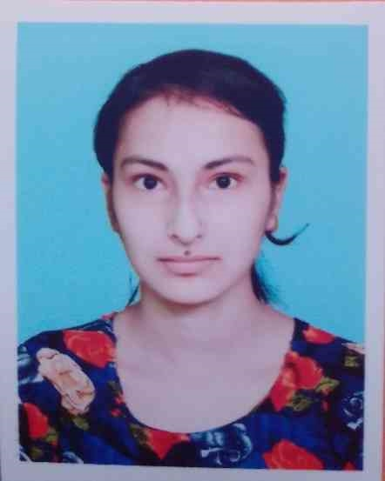
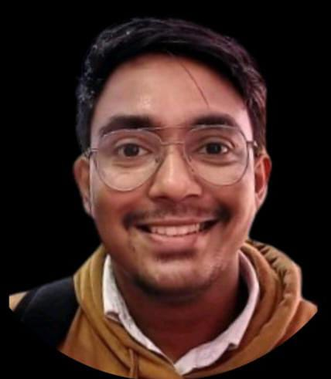
Team Members
Dr. Tanima Bhowmik
Department of Computer Science and Technology(Artificial Intelligence and Machine Learning)
Pratyusha Chatterjee
Department of Computer Science and Technology(Artificial Intelligence and Machine Learning)
Debajyoti Mitra
Department of Computer Science and Technology(Artificial Intelligence and Machine Learning)
Acknowledgement
Institute of Enginerring and Mangement
University of Engineering and Management
Kolkata, India

Slide 3
Problem Statement
Inefficient Farm Monitoring: Manual inspections and periodic soil testing cause delays in detecting crop diseases, pest infestations, and soil deficiencies, reducing productivity.
Lack of Real-Time Insights: Farmers struggle with limited access to real-time data on soil health, crop conditions, and livestock movement, leading to inefficient decision-making.
Pest and Disease Management Gaps: Without automated detection, pest infestations and crop diseases go unnoticed, impacting crop yield, quality, and overall farm sustainability.
High Labor Dependence: Traditional livestock management and farming methods are time-consuming, labor-intensive, and increase operational costs without technological intervention.
Limited AI Integration: The absence of machine learning-driven analytics prevents precise pest detection, crop classification, and predictive insights for optimized farm management.
User-Friendly Farm Monitoring Software: A seamless platform providing farmers with easy access to real-time insights, visualization tools, and AI-driven analytics.

Slide 4
Introduction
Farmers face persistent challenges like pest infestations, crop diseases, and inefficient livestock management, affecting productivity and sustainability.
Traditional agricultural practices rely on manual monitoring, which is time-consuming, inaccurate, and lacks real-time data-driven insights.
Combining drones, Dew Nodes, and AI-driven analytics enables automated farm surveillance, precise soil monitoring, and crop health assessment.
AI-powered algorithms enhance precision farming by detecting pests, identifying diseases, and analyzing crop growth stages for better decision-making.
A dedicated software platform provides real-time visualization, AI-driven insights, and automated alerts, ensuring ease of access for farmers.
A holistic, technology-driven system optimizes resource usage, improves farm efficiency, and promotes sustainable, data-driven farming practices.

Slide 5
Research Survey
Nadia Delavarpour et al. integrated UAVs with advanced technology for precision farming, improving yield and reducing costs. Limitations include resolution constraints and weather dependence, requiring better sensing technologies and methodologies.
Cacan Song et al. analyzed UAV-based granular fertilizer spreaders, finding GFS-D most effective for precise variable-rate fertilization. Future work focuses on developing an autonomous system for site-specific fertilizer application.
Rashmi Priya Sharma et al. proposed an IoT and fuzzy-logic system for pest prediction in rice and millet, considering meteorological impacts. Future improvements include optimizing fuzzy logic with genetic algorithms for better accuracy on edge devices.
Nurzaman Ahmed et al. proposed a scalable IoT network using WiFi and fog computing, prioritizing low latency. Future work should enhance data rates, bandwidth allocation, and security while addressing privacy concerns.
Dimosthenis C. Tsouros et al. highlighted IoT’s role in precision farming, emphasizing real-time data for better decisions. Future research should standardize UAV operations, improve data collection, and enhance accuracy in yield forecasting.

Slide 6
Proposed Solution
Sensor-Equipped Farm Drone: Develop a drone with cameras and multispectral sensors to capture real-time aerial data for crop and soil monitoring. It enhances precision farming by detecting anomalies in crop health and environmental conditions.
Dew Nodes for Soil Monitoring: Deploy compact ground-based sensors to track soil nutrients, moisture levels, and other essential parameters. These sensors transmit real-time data to the system for better farm management.
Automated Data Collection & Processing: Integrate data from drones and Dew Nodes to analyze crop health, soil conditions, and pest infestations. The system processes data onboard or sends it to a ground station for further insights.
AI-Powered Pest & Disease Detection: The farm drone captures multispectral and thermal images to detect early signs of crop stress, pests, and diseases. Using computer vision and AI, it classifies anomalies into fungal, bacterial, or viral infections, enabling precise identification and early intervention to prevent disease spread.
Crop Recognition & Growth Analysis: The system utilizes soil data from Dew Nodes, analyzing nutrients, moisture, and environmental conditions to suggest the most suitable crops for a given farmland. By leveraging machine learning algorithms, it ensures optimal crop selection for maximizing yield and sustainability.
Smart Livestock Management: Develop drones with autonomous flight paths and real-time tracking for efficient cattle herding. This reduces labor costs and enhances livestock safety and monitoring.
User-Friendly Farm Monitoring Software: Build an AI-driven platform with visualization tools, real-time analytics, and automated alerts. It ensures farmers can easily interpret data and make informed decisions.
Integration, Testing & Deployment: Combine drones, Dew Nodes, and AI software into a unified system, followed by extensive testing. Train farmers to use the technology effectively for real-world agricultural applications.

Slide 7
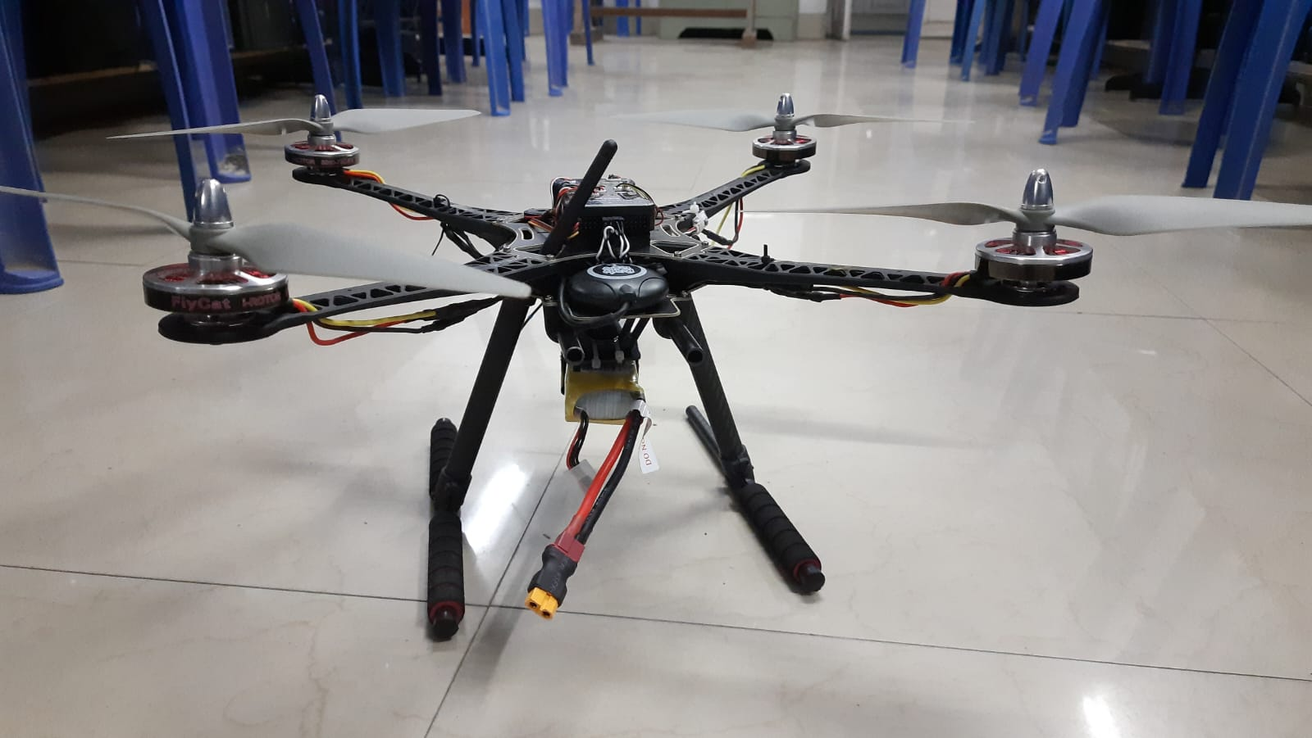
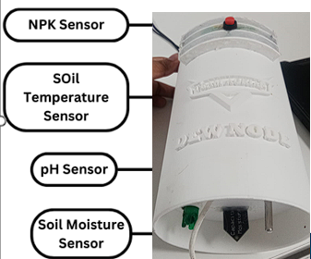
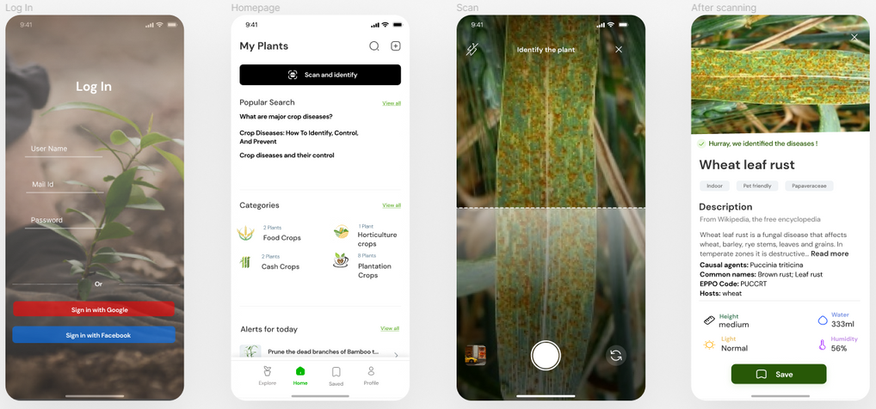
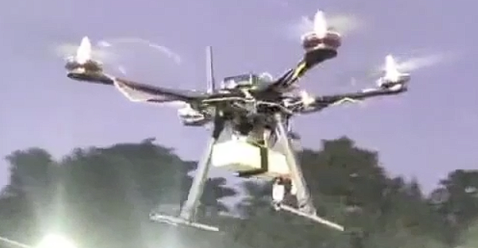
Prototype
Advanced Sensor-Equipped Drones: Our prototype leverages aerial robotics, AI, and IoT to revolutionize farm monitoring, ensuring efficient and data-driven agricultural practices.
AI-Powered Precision Farming: Integrating machine learning and aerial imaging, the system detects crop health issues, pest infestations, and livestock movement for timely interventions.
Real-Time Farm Intelligence: Multispectral and thermal imaging helps identify crop stress, nutrient deficiencies, and early disease symptoms. AI models classify infections as fungal, bacterial, or viral, enabling targeted treatment.
Dew Nodes for Soil Health Monitoring: Ground-based smart sensors track soil nutrients, moisture levels, and environmental factors, offering comprehensive farm data when combined with drone analytics.
Seamless Agricultural Integration: Designed with a user-friendly interface, the system ensures easy adoption, allowing farmers to make informed decisions with minimal technical expertise.
Our Prototype Model :
Our Assistant App :

Slide 8

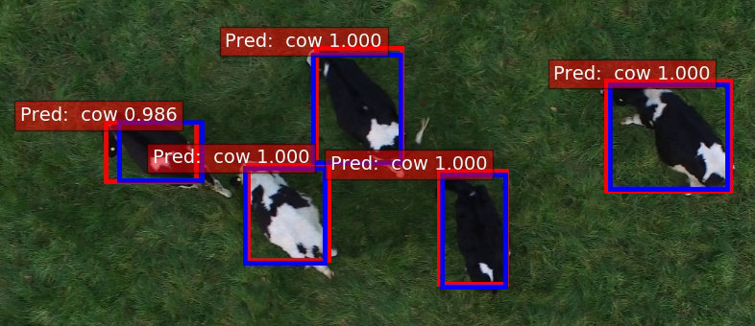
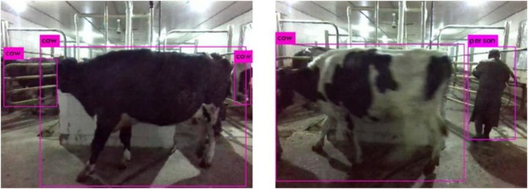
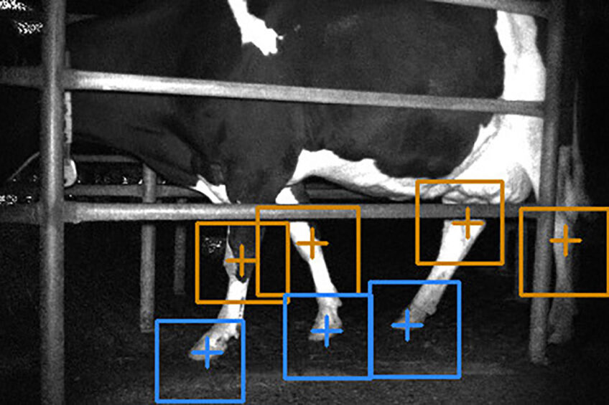
CATTLE DETECTION AND MANAGEMENT SYSTEM:
HELPS IN ANALYSIS CATTLE DISEASE
HELPS IN KNOWING THEIR BREEDING AND FOOD CYCLE
HELPS IN ANALYSING THEIR BEHAVIOURS

Slide 9

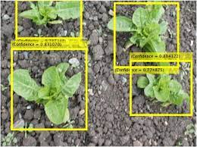
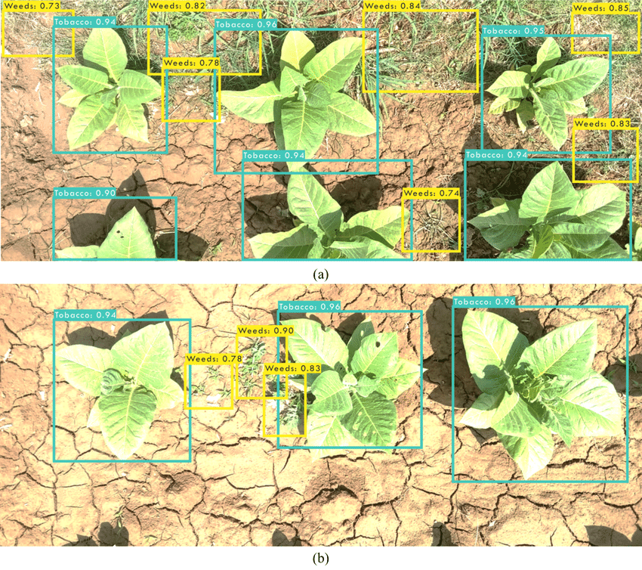
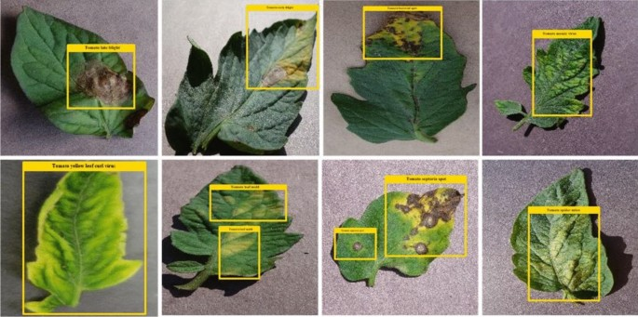
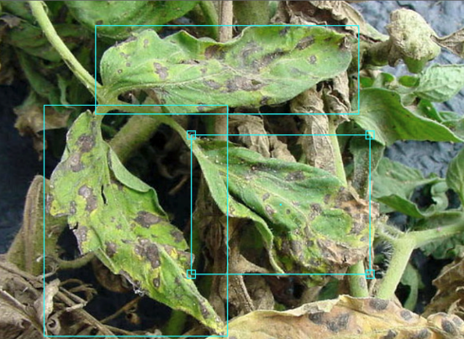
CROP AND WEED DETECTION
Crop and weed Classification for cultivating and Analysis
Helps us in stress and strain analysis and also among good and bad crops
Helps us in analyzing the crop disease and the location where it is occurring by dew analysis and solution at the fingertips

Slide 10
Advantages:
Disadvantages:
Real-Time Monitoring & Precision Insights: Provides accurate, real-time data on crop health, pests, soil conditions, and livestock movement, enabling quick decision-making.
Optimized Resource Utilization: Reduces excessive use of fertilizers, pesticides, and water through data-driven recommendations, improving sustainability and cost-effectiveness.
Improved Yield & Pest Control: Early detection of diseases and pest infestations prevents crop damage, ensuring better yield quality and quantity.
Reduced Labor & Increased Efficiency: Automates farm surveillance and livestock management, minimizing manual efforts and operational costs.
Technical Dependency & Maintenance: Requires regular software updates, sensor calibration, and skilled operation, posing difficulties in rural areas with limited technical expertise.

Slide 11
Conclusion
Revolutionizing Agriculture with Smart Technology: The integration of drones, AI, and IoT enhances precision farming, enabling real-time monitoring and data-driven decision-making.
Improved Efficiency & Sustainability: The system optimizes resource usage, reduces manual labor, and promotes sustainable farming practices for better yield and environmental conservation.
Enhanced Pest & Disease Management: Early detection and AI-powered analytics help prevent crop losses, ensuring higher productivity and improved farm profitability.
Bridging Technology & Farmer Accessibility: A user-friendly interface and automated insights make advanced agricultural technology accessible and practical for farmers of all scales.
Future Scope & Scalability: With further advancements in AI, connectivity, and automation, the system can be expanded to support more crops, livestock management, and climate adaptation strategies.

Slide 12
References
[1] Tanima Bhowmik, Debajyoti Mitra and Pratyusha Chatterjee, "Machine Learning BasedCrop Recommendation Model in Precision Agriculture," 2024 International Conferenceon Emerging Smart Computing and Informatics (ESCI), Pune, India, 2-24. pp. 1-6, doi:10.1109/ESCI59607.2024.10497421.
[2] Demilie, W.B.,"Plant Disease Detection and Classification Techniques: a ComparativeStudy of the Performances." Journal of Big Data, 11(1), p.5 , 2024.
[3] Adhinata, F.D. and Sumiharto, R., "A Comprehensive Survey on Weed and CropClassification Using Machine Learning and Deep Learning." Artificial Intelligence inAgriculture,2024.
[4] Amrani, A., Diepeveen, D., Murray, D., Jones, M.G. and Sohel, F., "Multi-Task LearningModel for Agricultural Pest Detection from Crop-Plant imagery: A Bayesian Approach.Computers and Electronics in Agriculture, 218, p.108719, 2024.
[5] Chen, C.J., Huang, Y.Y., Li, Y.S., Chang, C.Y. and Huang, Y.M. "An AIoT-based SmartAgricultural System for Pests Detection." IEEE Access, 8, pp.180750-180761, 2020.
[6] Radoglou-Grammatikis, P., Sarigiannidis, P., Lagkas, T. and Moscholios, I., "A Com-pilation of UAV Applications for Precision Agriculture," Computer Networks, 172,p.107148, 2020.
[7] Mekonnen, Yemeserach, Srikanth Namuduri, Lamar Burton, Arif Sarwat, and ShekharBhansali. "Machine Learning Techniques in Wireless Sensor Network based PrecisionAgriculture." Journal of the Electrochemical Society 167, no. 3 (2019): 037522, 2019.
[8] Meena, S.D., Susank, M., Guttula, T., Chandana, S.H. and Sheela, J., "Crop YieldImprovement with Weeds, Pest and Disease Detection." Procedia Computer Science,218, pp.2369-2382.
[9] Mythili, K. and Rangaraj, R., "Deep Learning with Particle Swarm based Hyper-parameter Tuning based Crop Recommendation for Better Crop Yield for PrecisionAgriculture." Indian Journal of Science and Technology, 14(17), pp.1325-1337, 2021.
[10] Senapaty, Murali Krishna, Abhishek Ray, and Neelamadhab Padhy. "IoT-enabledSoil Nutrient Analysis and Crop Recommendation Model for Precision Agriculture."Computers 12, no. 3:61, 2023.
[11] Thilakarathne, N.N., Bakar, M.S.A., Abas, P.E. and Yassin, H., "A Cloud-enabled CropRecommendation Platform for Machine Learning-driven Precision Farming," Sensors,22(16), p.6299, 2022.
[12] Mythili, K., and R. Rangaraj. "Crop Recommendation for Better Crop Yield for Preci-sion Agriculture using Ant Colony Optimization with Deep Learning Method." Annalsof the Romanian Society for Cell Biology (2021): 4783-4794, 2021.
[13] Boudaa, B., Abada, K., Aichouche, W.A. and Belakermi, A.N., "April. AdvancingPlant Diseases Detection with Pre-trained YOLO Models." In 2024 6th InternationalConference on Pattern Analysis and Intelligent Systems (PAIS) (pp. 1-6). IEEE, 2024.
[14] Choudhary, Mahendra, Rohit Sartandel, Anish Arun, Leena Ladge, Saroj Hiranwal,and Garima Mathur. "Crop Recommendation System and Plant Disease Classifica-tion using Machine Learning for Precision Agriculture." In Artificial Intelligence andCommunication Technologies, SCRS, pp. 39-49. 2022.

Slide 13

Thank You

